Slide 1
DISORDERS OF THE CONJUNCTIVA
Dunera R. Ilako

Slide 2
APPLIED ANATOMY
Epithelium
  Stratified, squamous, non-keratinized
Stroma
  Highly vascularised
Mucin secretors
  Goblet cells
  Crypts of Henle
  Glands of Manz
Accessory lacrimal glands
  Kraus and Wolfring
Three clinical parts
  Palpebral, Forniceal, Bulbar.

Slide 3
CLINICAL EVALUATION
Clinical Feature for differential diagnosis
  Symptoms
  Types of discharge
  Conjuntival appearance
  Presence of membranes
  Lymphadenopathy

Slide 4
SYMPTOMS
Non-specific
  Lacrimation
  Irritation
  Stinging
  Burning
  Photophobia
  +/- pain & foreign sensation

Slide 5
TYPE OF DISCHARGE
Watery
Mucoid
Purulent
Mucopurulent

Slide 6
CLINICAL APPEARANCE
Conjunctival injection
Sub-conjunctival hemorrhages
Follicular reaction
Papillary reaction
Edema
Scarring

Slide 7
CONT.
MEMBRANES
True membranes
Pseudomebranes
LYMPHADENOPATHY
Infections: viral, bacterial, chlamydial
Parinaud’s syndrome/ Dorsal Midbrain syndrome/ Vertical Gaze Palsy/ Sunset sign
  Inability to move the eyes up due to a tumor in the pineal gland which compresses the vertical gaze center.

Slide 8
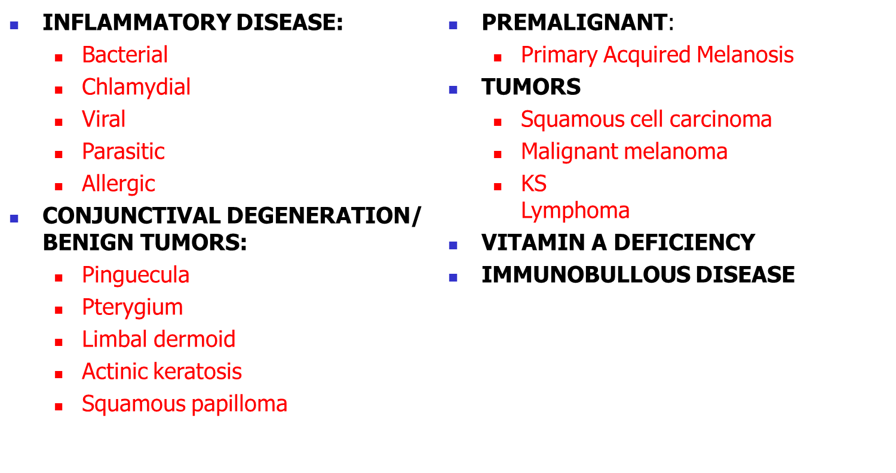
CONJUNCTIVAL DISORDERS

Slide 9
CONJUNCTIVAL INFECTIONS
Bacterial
  Simple Bacterial
  Gonococcal Keratoconjunctivitis
Viral
  Adenoviral keratoconjunctivitis
  Molluscum contagiosum conjunctivitis
  Herpes simplex virus conjunctivitis
Chlamydial
  Adult
  Neonatal
  Trachoma

Slide 10
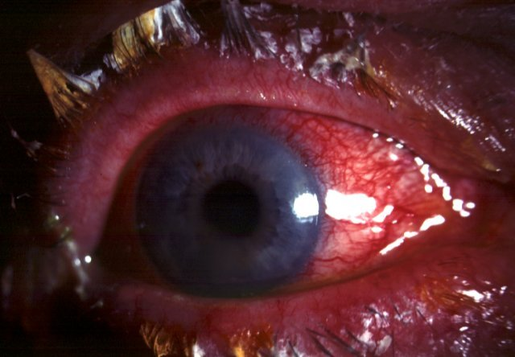
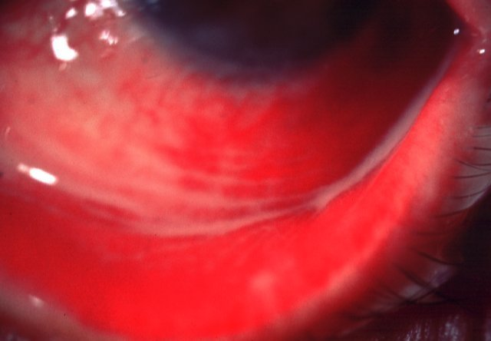
SIMPLE BACTERIAL CONJUNCTIVITIS
Signs
Crusted eyelids and conjunctival
injection
Subacute onset of mucopurulent
discharge
Treatment
- broad-spectrum topical antibiotics

Slide 11
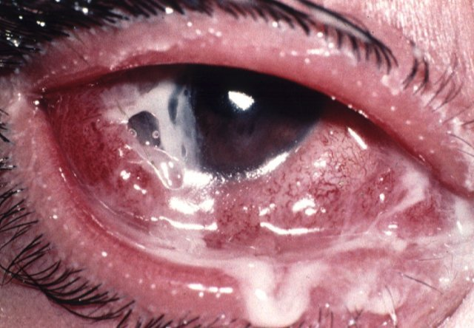
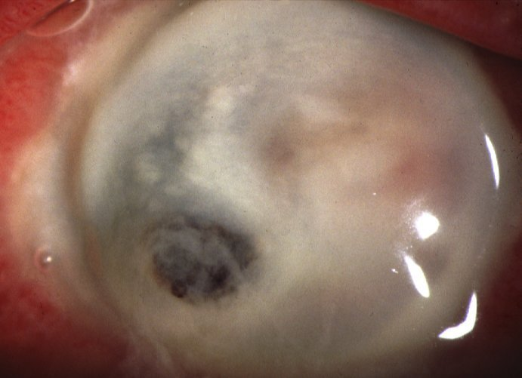
GONOCOCCAL KERATOCONJUNCTIVITIS
Signs
Complications
Acute, profuse, purulent discharge,
hyperaemia and chemosis
Corneal ulceration, perforation
and endophthalmitis if severe
Treatment
Topical gentamicin and bacitracin
Intravenous cefoxitin or cefotaxime

Slide 12
Adenoviral Keratoconjunctivitis
Pharyngoconjunctival fever
  Adenovirus types 3 and 7
  Typically affects children
  Upper respiratory tract infection
  Keratitis in 30% - usually mild
Epidemic keratoconjunctivitis
  Adenovirus types 8 and 19
  Very contageous
  No systemic symptoms
  Keratitis in 80% of cases - may be severe

Slide 13
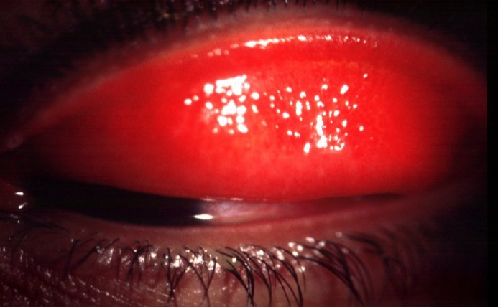
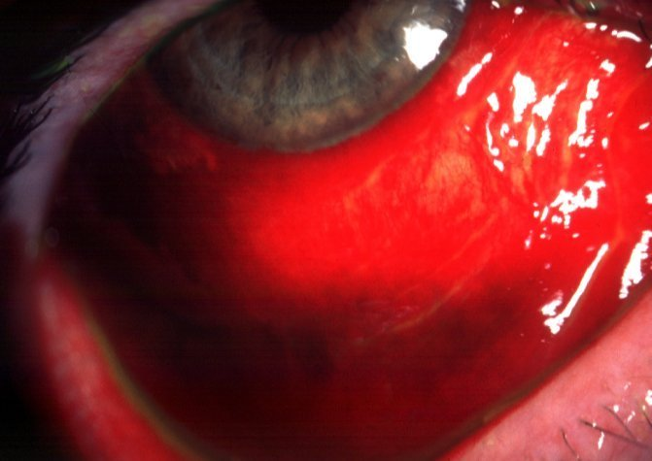
Signs of conjunctivitis
Subconjunctival haemorrhages and
pseudomembranes if severe
Usually bilateral, acute watery
discharge and follicles
Treatment
- symptomatic

Slide 14
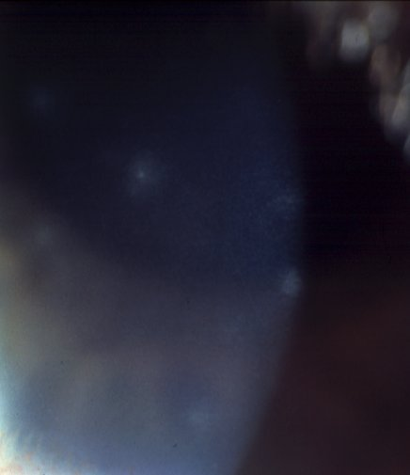
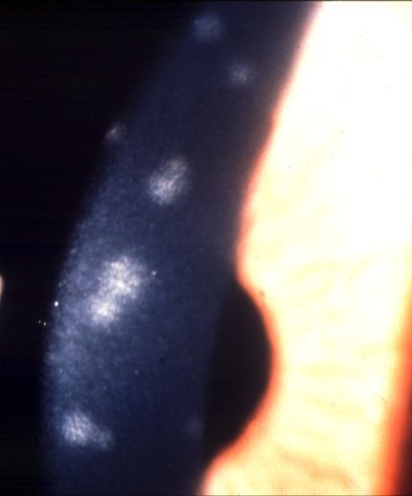
Signs of Keratitis
Focal, epithelial keratitis
Focal, subepithelial keratitis
May persist for months
Transient
Treatment
topical steroids if visual acuity
diminished by subepithelial keratitis

Slide 15
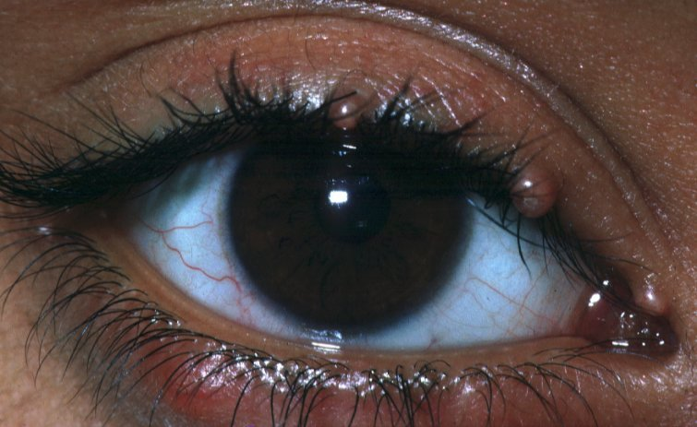
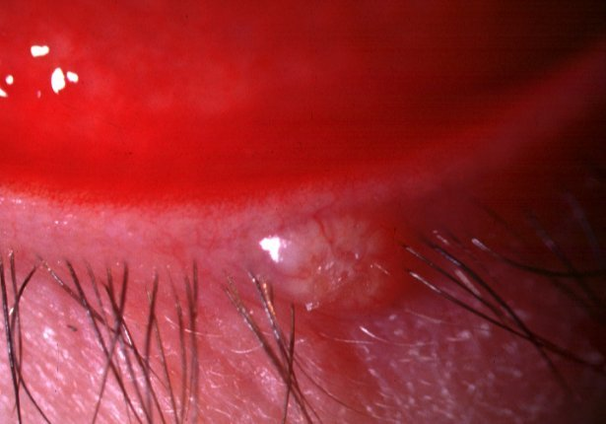
Molluscum Contagiosum Conjunctivitis
Signs
Waxy, umbilicated eyelid nodule
Ispilateral, chronic, mucoid discharge
May be multiple
Follicular conjuntivitis
Treatment
destruction of eyelid lesion

Slide 16
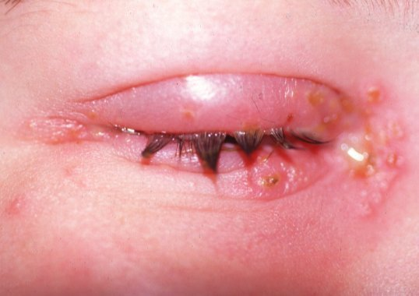
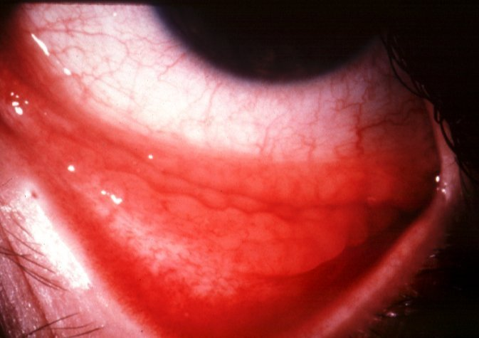
Herpes simplex conjunctivitis
Signs
Unilateral eyelid vesicles
Acute follicular conjunctivitis
Treatment
topical antivirals to prevent keratitis

Slide 17
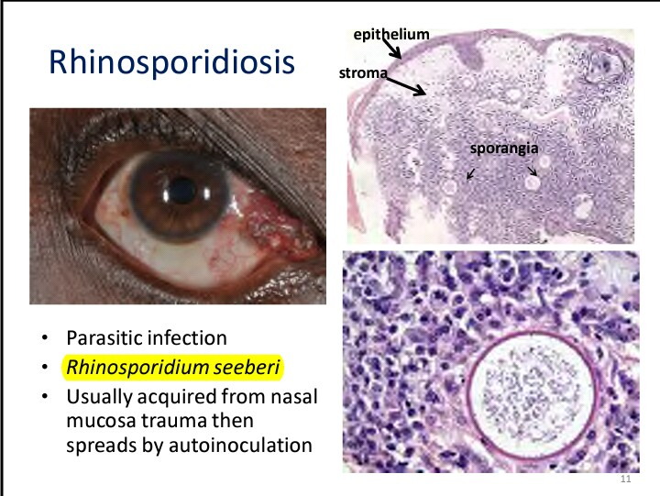

Slide 18
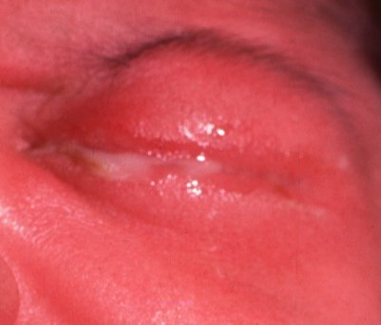
Neonatal chlamydial conjunctivitis
Presents between 5 and 19 days after birth
May be associated with otitis, rhinitis and pneumonitis
Mucopurulent papillary conjunctivitis
Treatment
- topical tetracycline and oral erythromycin

Slide 19
ALLERGIC CONJUNCTIVITIS
1. Allergic rhinoconjunctivitis
2. Vernal keratoconjunctivitis
3. Atopic keratoconjunctivitis

Slide 20
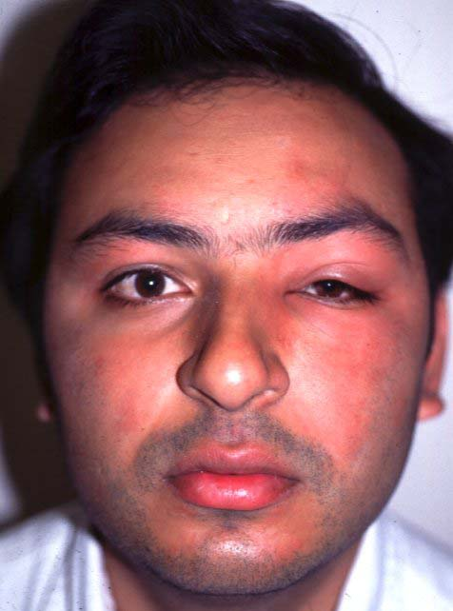
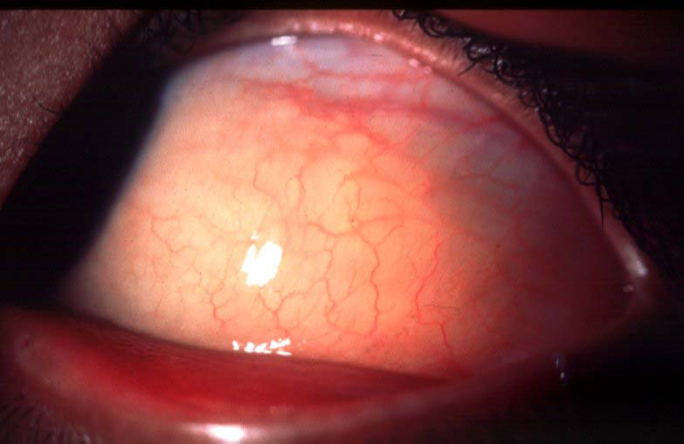
Allergic rhinoconjunctivitis
Transient conjunctival oedema
Transient eyelid oedema

Slide 21
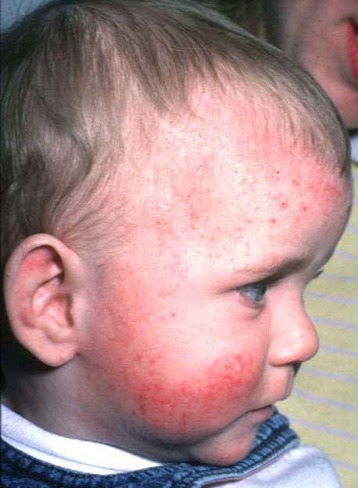
Vernal Keratoconjunctivitis
Frequently associated with atopy: asthma, hay fever and dermatitis
Recurrent, bilateral
Affects children and young
adults
More common in males
and in warm climates
Itching, mucoid discharge
and lacrimation
Types
Palpebral
Limbal
Mixed
Treatment
Topical mast cell stabilizers
Topical steroids

Slide 22
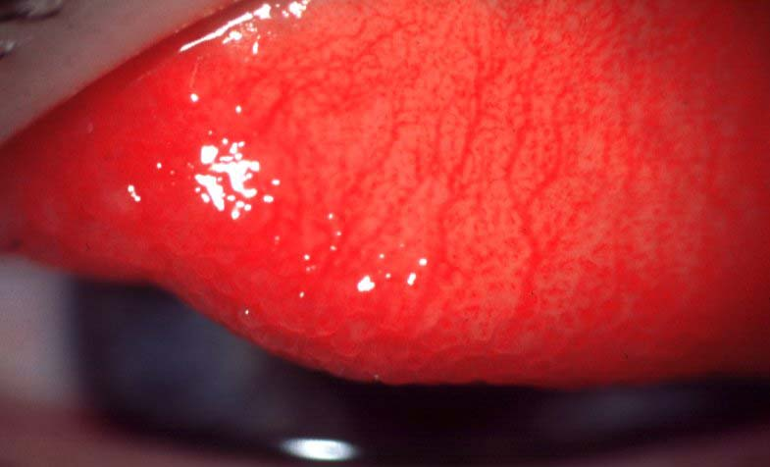
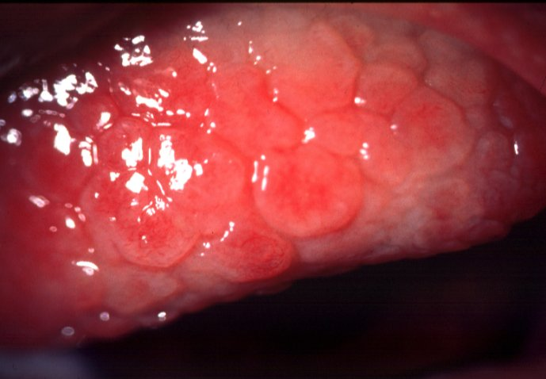
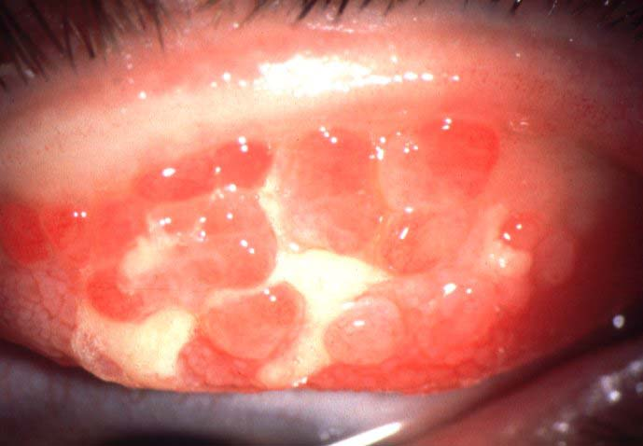
Progression of vernal conjunctivitis
Diffuse papillary hypertrophy, most marked on superior tarsus
Formation of cobblestone papillae
Rupture of septae - giant papillae

Slide 23
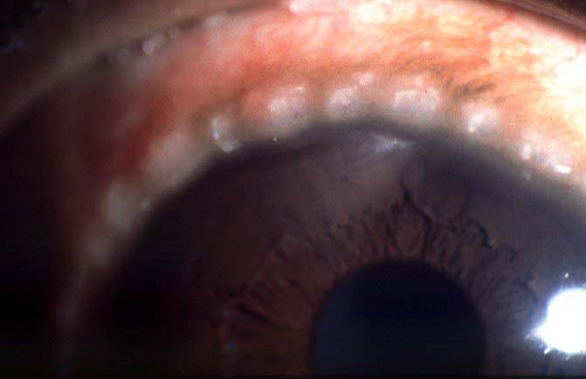
Limbal vernal
Mucoid nodule
Trantas dots

Slide 24
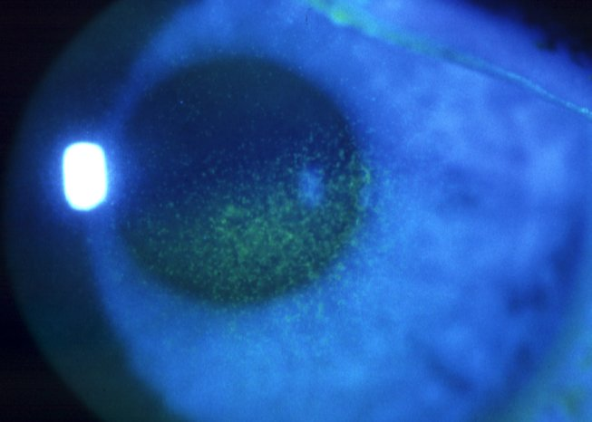
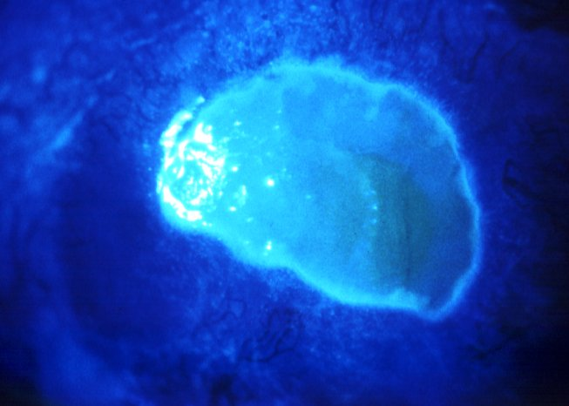
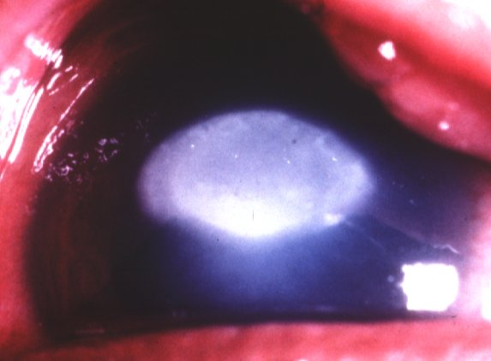
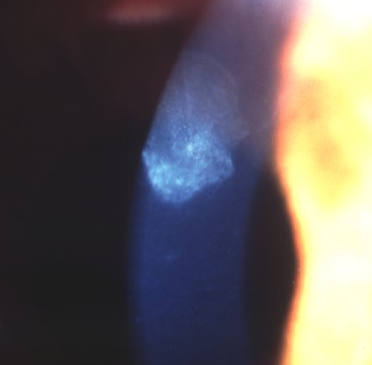
Progression of Vernal Keratopathy
Punctate epitheliopathy
Epithelial macroerosions
Plaque formation (shield ulcer)
Subepithelial scarring

Slide 25
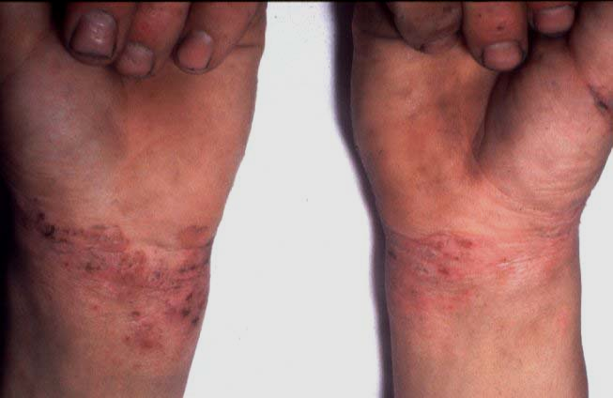
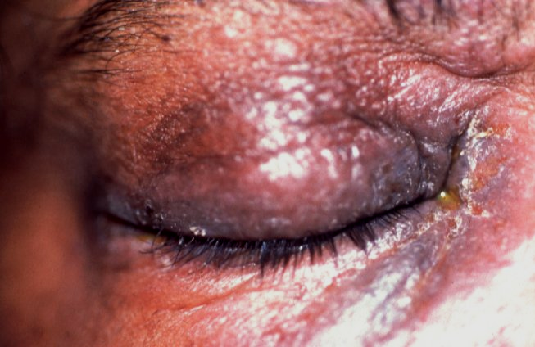
Atopic Keratoconjunctivitis
Typically affects young patients with
atopic dermatitis
Eyelids are red, thickened, macerated
and fissured

Slide 26
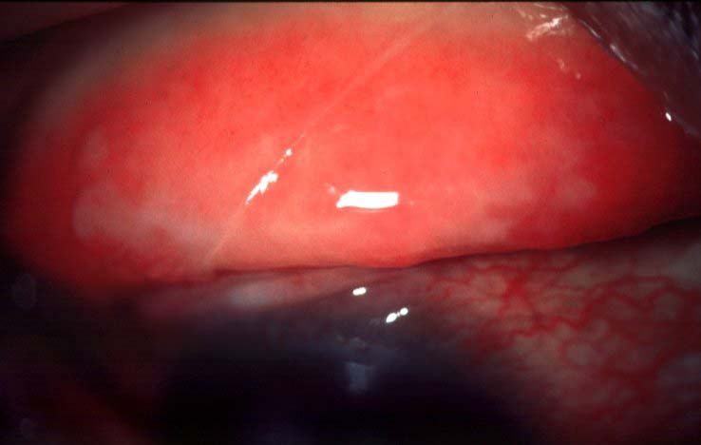
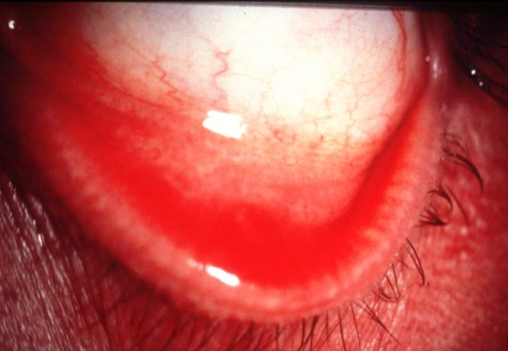
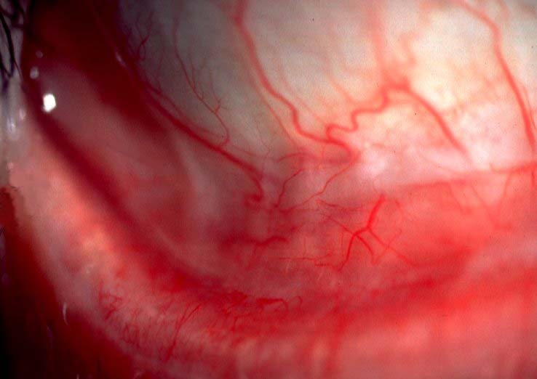
Progression of atopic conjunctivitis
Infiltration of tarsal conjunctiva causing featureless appearance
Inferior forniceal papillae
Mild symblepharon formation

Slide 27
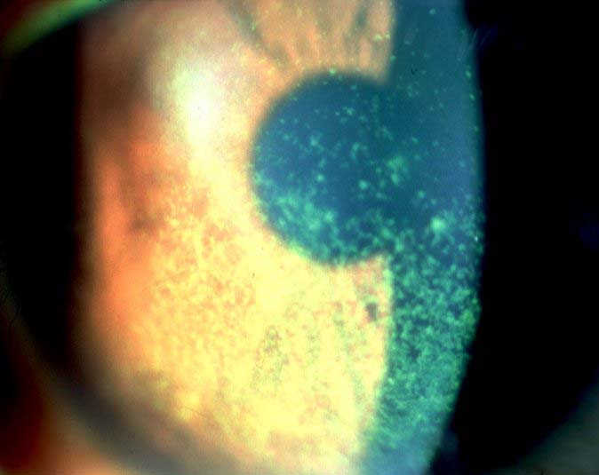
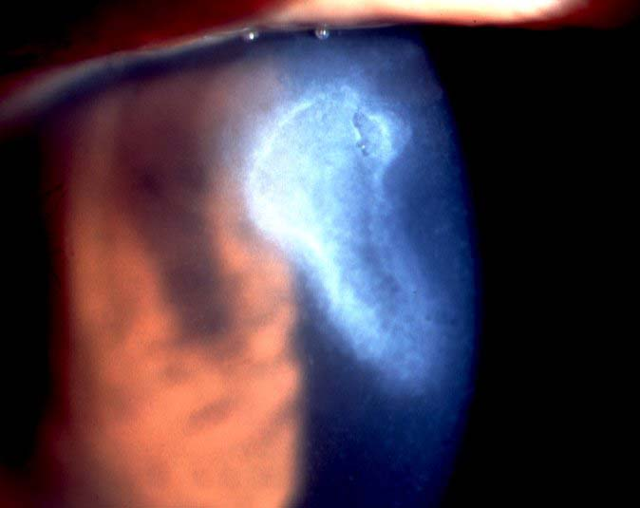
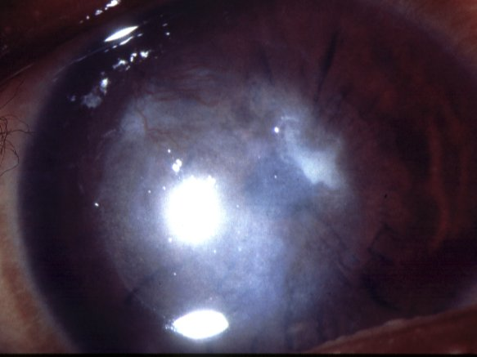
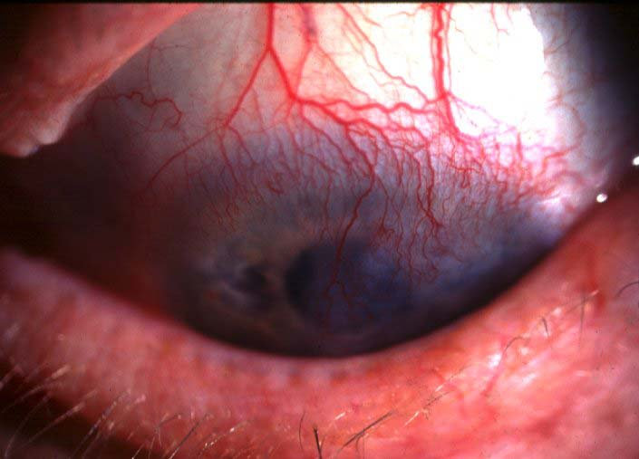
Progression of Atopic Keratopathy
Punctate epitheliopathy
Persistent epithelial defects
Subepithelial scarring
Peripheral vascularization

Slide 28
Conjunctival Tumours
Benign
  Naevus
  Papilloma
  Epibulbar dermoid
  Lipodermoid
Pre-malignant
  Primary acquired melanosis ( PAM )
  Intraepithelial neoplasia (carcinoma in situ)
Malignant
  Melanoma
  Squamous cell carcinoma
  Kaposi sarcoma
  Lymphoma

Slide 29
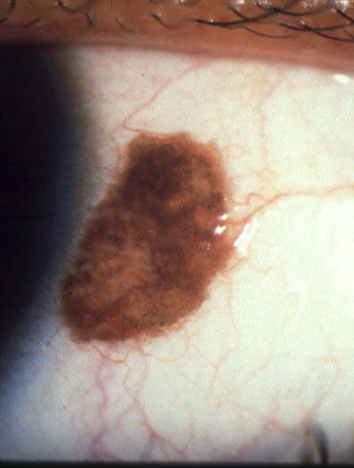
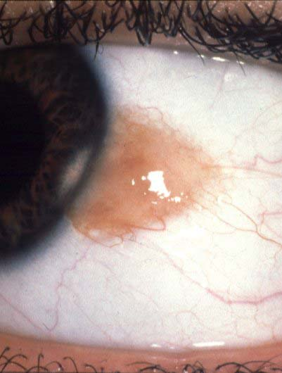
Naevus
Presents in first two decades
Most frequently juxtalimbal
Sharply demarcated and slightly
elevated
30% are almost non-pigmented

Slide 30
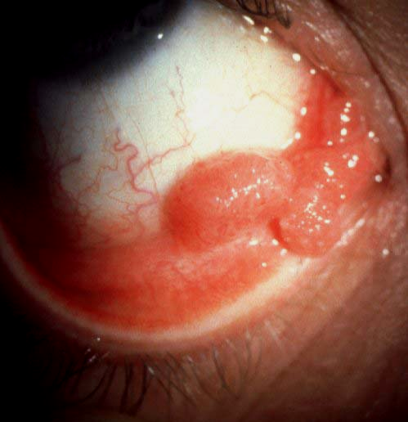
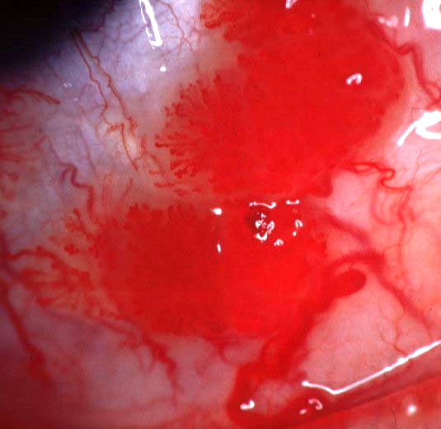
Papilloma
Pedunculated
Sessile
Presents in childhood or early
adulthood
Presents in middle age
Infection with papilloma virus
Not caused by infection
May be multiple and bilateral
Single and unilateral

Slide 31
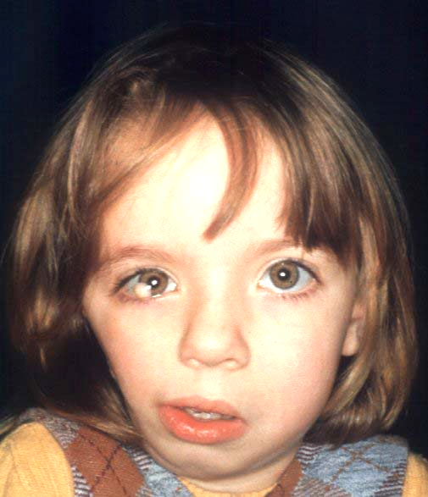
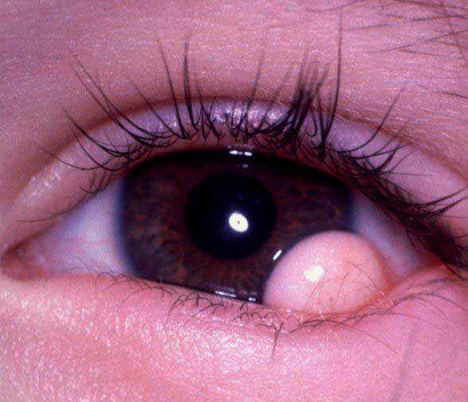
Epibulbar dermoid
Signs
Association
Presents in childhood
Occasionally Goldenhar
syndrome
Smooth, soft mass
Usually juxtalimbal

Slide 32
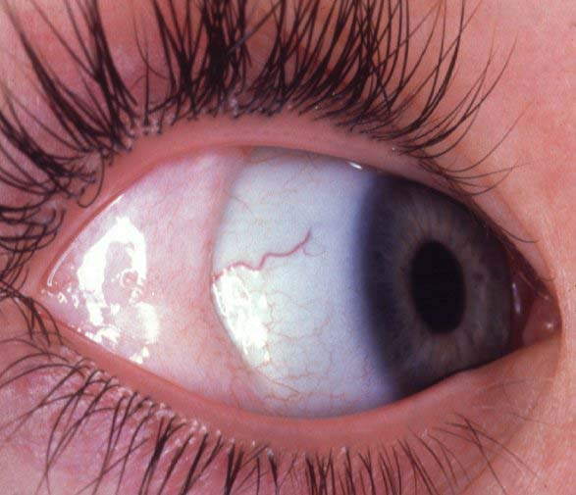
Lipodermoid
Presents in adulthood
Soft, movable, subconjunctival mass
Most frequently at outer canthus

Slide 33
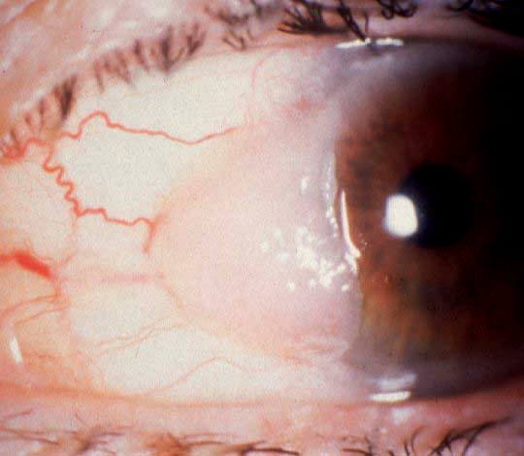
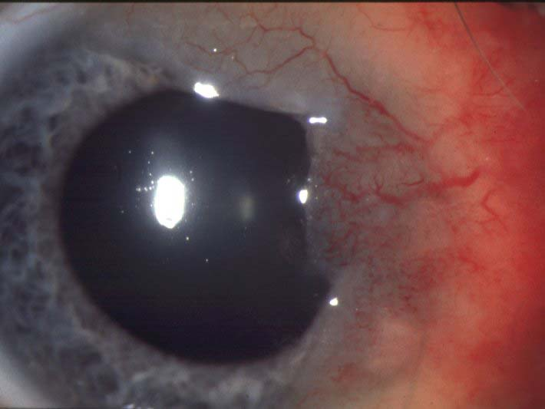
Intraepithelial neoplasia
(carcinoma in situ)
Signs
Progression
Presents in late adulthood
May become vascular and extend onto
cornea
Juxtalimbal fleshy avascular mass
Malignant transformation is uncommon

Slide 34
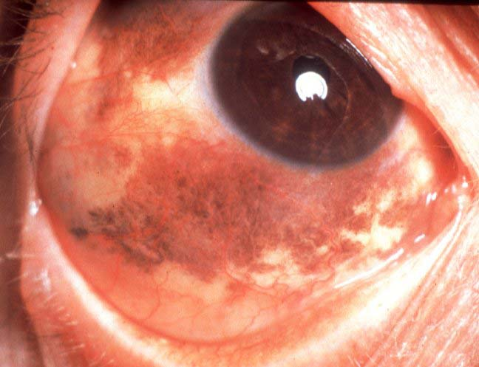
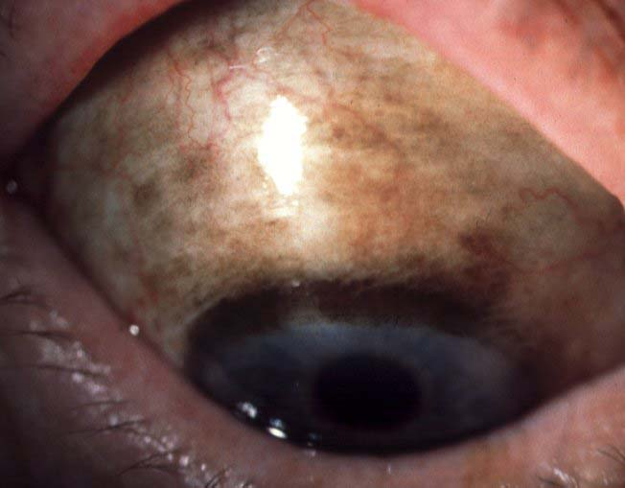
Primary acquired melanosis (PAM)
Signs
Types
Presents in late adulthood
PAM without atypia is benign
Unilateral, irregular areas of flat,
brown pigmentation
PAM with atypia is pre-malignant
May involve any part of conjunctiva

Slide 35
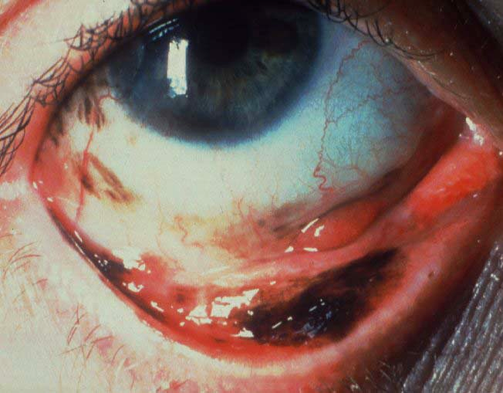
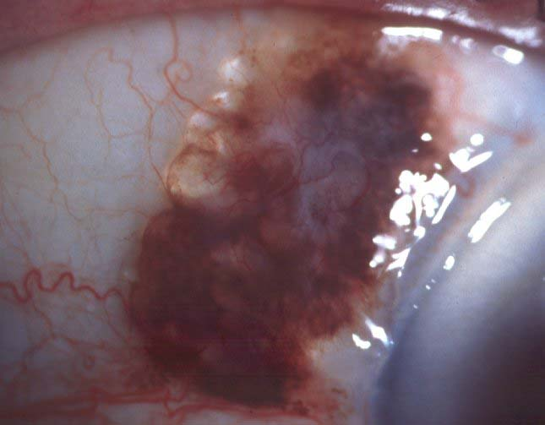
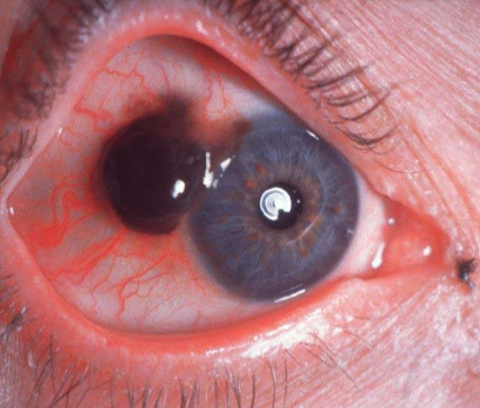
Conjunctival melanoma
From PAM with atypia
From naevus
Primary
Most common type
Very rare
Solitary nodule
Sudden appearance of
nodules in PAM
Sudden increase in size
or pigmentation
Frequently juxtalimbal
but may be anywhere

Slide 36
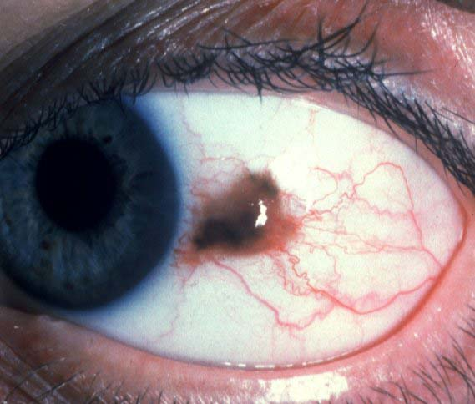


Treatment of conjunctival melanoma
Localized tumour
Diffuse tumour
Orbital recurrence
Excision
Excision of nodules
Excision and
radiotherapy
Adjunctive cryotherapy
Adjunctive cryotherapy or
mitomycin C
Exenteration

Slide 37


Squamous cell carcinoma
Signs
Progression
Arises from intraepithelial
neoplasia or de novo
Slow-growing
May spread extensively
Presents in late adulthood
Rarely metastasizes
Frequently juxtalimbal

Slide 38

Kaposi sarcoma
Affects patients with AIDS
Vascular, slow-growing tumour of low malignancy
Very sensitive to radiotherapy
Most frequently in inferior fornix

Slide 39

Lymphoma
Usually presents in adulthood
Benign or malignant
Salmon-coloured, subconjunctival infiltrate

